Slide 1

Python
Coding

Slide 2
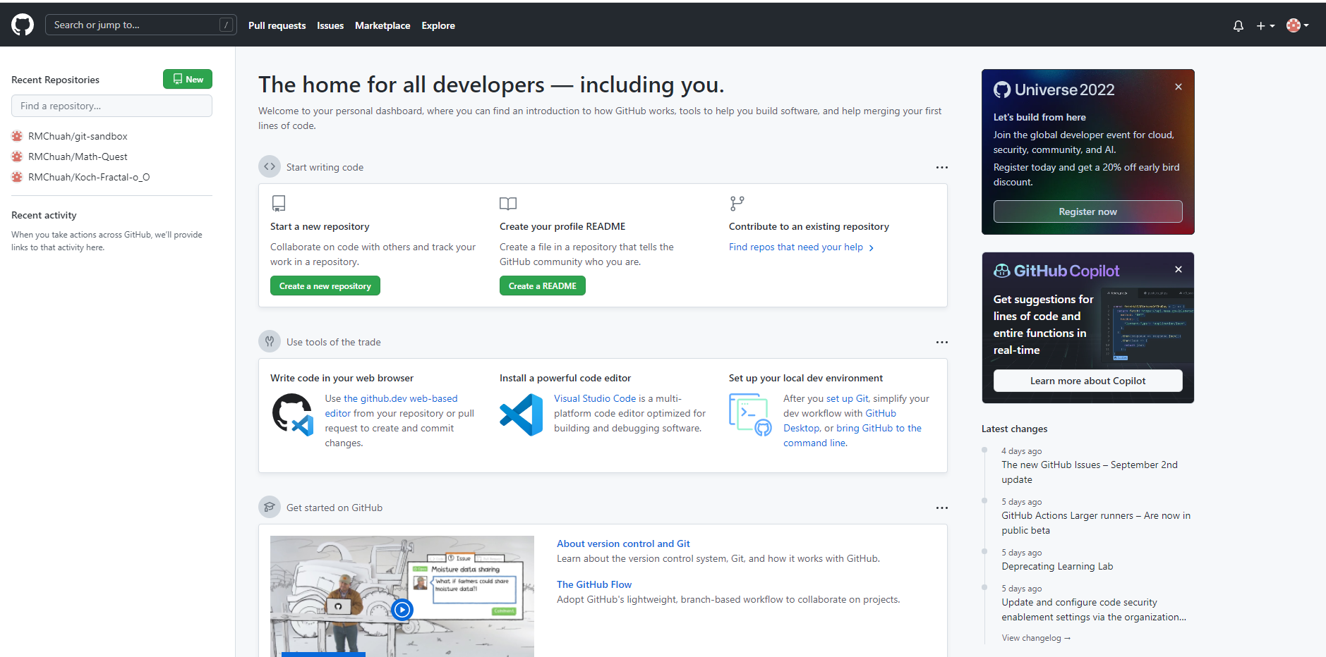
1. Sign up Git Hub
Click this link= https://github.com/

Slide 3
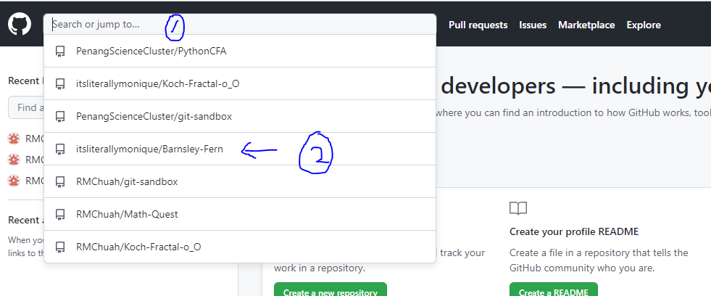
2. Click Search or jump to Then choose Barnsley-Fern

Slide 4
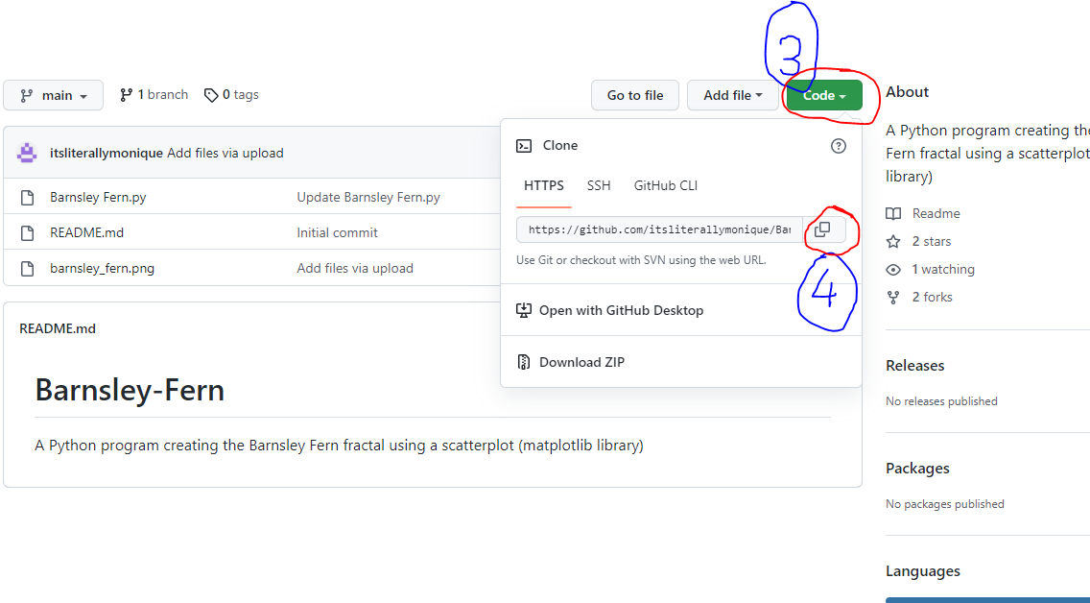
3. Click Code (the green button) Then copy the link

Slide 5
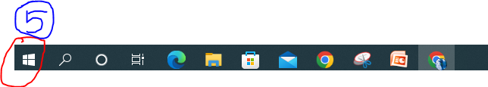
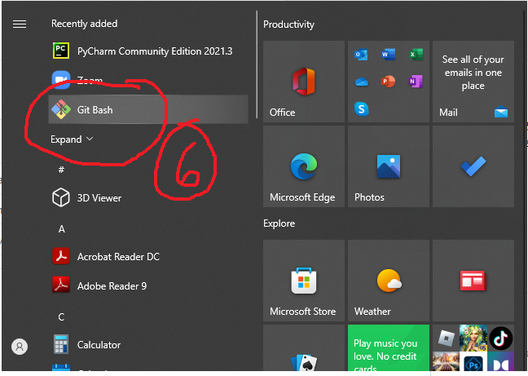
4. Go to the start button Choose Git Bash

Slide 6
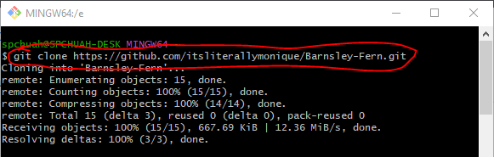
5. Type= git clone (paste the link) Press Enter(keyboard)

Slide 7
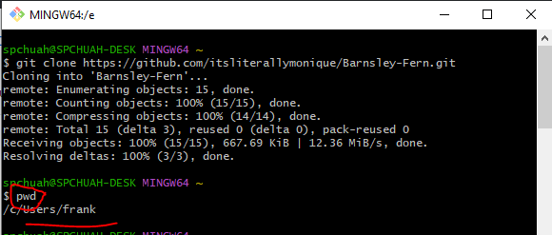
6. Type pwd Then press Enter

Slide 8
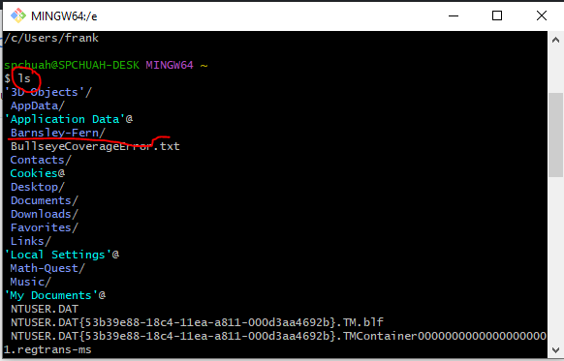

7.Type ls Press Enter Barnsley-Fern is already inside this Users file
8.Click Window Explorer

Slide 9
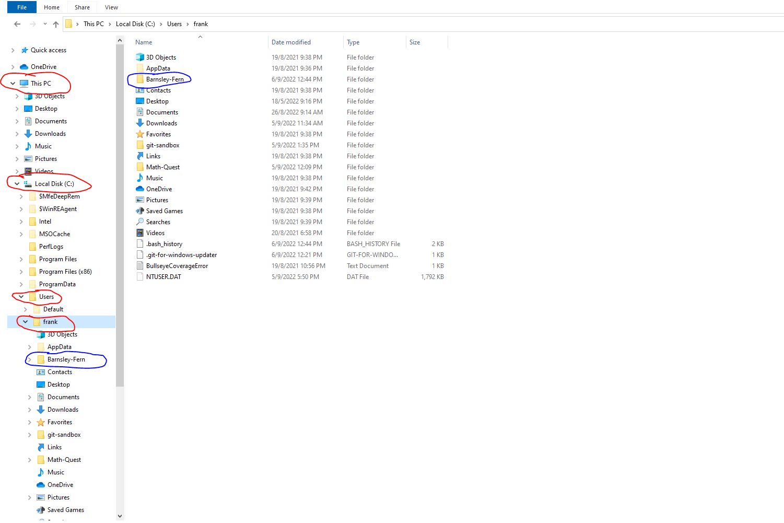
Click This PC, then click Local Disk C,then click Users file, find frank and you will see Barnsley-Fern in the file.

Slide 10
The End Thank You

